Slide 1
Welcome to the
Alabama Technology Foundation
developing qualified information technology
specialists to meet Alabama’s growing need for
highly‐skilled technology professionals
Alabama Technology Foundation
P.O. Box 240036 - Montgomery, AL 36124
www.AlabamaTechnologyFoundation.org
ATF@AlabamaTechnologyFoundation.org

Slide 2
Agenda
Who is the ATF?
Vision, Goals, Objectives
Fast Facts
Initial Success: Storage Area Network CoE
Partnership: ATF, Academia, Industry
Programs & Partnering Opportunities

Slide 3
Alabama Technology Foundation
Non-profit 501(c)(3) economic development and outreach organization
Specializes in high tech IT in Alabama.
Academia: Curriculum support
Industry: Internships, Research
Students: Scholarships, College-to-Career
85% of all income goes directly to students

Slide 4
Alabama Technology Foundation
Focus:
Near term economic development
High total economic impact
Fills a necessary gap that impacts Quality of life today
Complementary to, not competitive with, other community activities

Slide 5
ATF Vision
To become a recognized leader for Alabama in curriculum and workforce development within the high-demand and high-growth information technology disciplines.
First Discipline – Storage Area Network (SAN)
Second Discipline – Application Security

Slide 6
ATF Goals
Expand AUM Storage CoE capabilities
Replicate SCoE’s statewide
Support Alabama business
Grow storage talent in AL to stay in Alabama
Grow high tech IT capability to stay in Alabama
Reduce “brain drain” in AL
Advance goals of ATF members
Provide opportunity through Scholarships
Integrate new programs as industry requires

Slide 7
Applied & Theoretical
Market Driven
IT Business Development
Training Capability
Direct Training
Train the Trainer
Develop trained and skilled workforce
Direct and Indirect Partnerships with Economic Development Entities
Program Promotion and Outreach
Connecting Capital, Human and Intellectual Resources to Programs
Cooperation & Coordination with Similar Institutions
Career Counseling & Job Placement
High School & University Students
Continuing Education
Business outreach / Job Fairs
Research & Development
Facilities, Resources and Tools
Scholarships, Professorships, Research and Infrastructure
Curriculum Development
Target Business Demand, Growth Opportunities and Specialization
Community Outreach & Public Speaking
Centers of Excellence
ATF Paths to Success

Slide 8
Fast Facts
AUM is one of 27 US schools affiliated with SNIA
ATF is an economic development activity
Alabama is uniquely positioned to capture IT:
“If you want to find the top-paying jobs in the U.S. Tech Industry, you may want to look in the obvious places—Montgomery AL., Idaho Falls, Idaho, and Fort Smith, Ark., for instance.”
Forbes.com article by Paul Maidment, 08.01.06, 12:00 PM ET
Notes:
AUM is one of 27 US schools affiliated with the Storage Networking Industry Association
Partnership between ATF, Alabama schools and Industry is a great economic tool that the state can continue to develop and grow.
Where are the Best Paying High tech Jobs?
Forbes.com article by Paul Maidment, 08.01.06, 12:00 PM ET
“If you want to find the top-paying jobs in the U.S. Tech Industry, you may want to look in the obvious places—Montgomery Al., Idaho Falls, Idaho, and Fort Smith, Ark., for instance.”

Slide 9
ATF First Discipline: Storage Area Network
High Demand; High growth; High Wages
Demand is high for trained Storage Administrators
Average Enterprise IT department has 4 – 8 Storage Professionals
Entry level salaries 40K to 70k
Skilled Salary range 70K to 100K
Medium salary $93,000

Slide 10
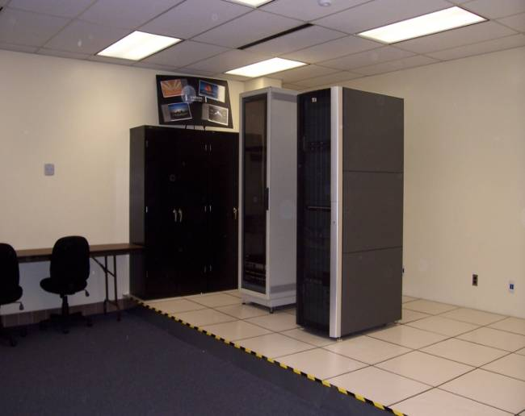
Partnership: ATF, AUM, Industry
Curriculum Development
Trained AUM Professors
Investments
SAN Lab Build out
Scholarships
Graduated SAN educated students
Internships awarded
Interns hired for permanent position
All accomplished during 1st Year!

Slide 11
AUM SAN Lab & Curriculum
18-seat, hands on lab gives graduates an advantage over their competition in the job market
Storage Curriculum provides Alabama with skilled employees.

Slide 12
Success Story: Ryan Ashley
Inaugural class student
“I believe I was accepted into my current job because of this course.”
“Having the opportunity to see how the technology works was a huge deciding factor in choosing Storage for a career.”

Slide 13
Partnership:
ATF Academia Industry

Slide 14
True Partnership
ATF
Performs needs demand & supply analysis
Fund and support curriculum development
Provides technology insertion & support
Academia
Curriculum development & delivery
Identifies high performing students
Industry
Internships & student hires
Provides needs forecasts to ATF

Slide 15
Programs Partnering Opportunities

Slide 16
ATF Scholarships
One and two year scholarships (up to $5k)
Tightly focused:
college juniors or seniors.
cumulative GPA of 2.5 or better.
GPA in their Major of 3.0 or better.
recommended by the educational institution’s faculty.
full time students with 12 or more hours per semester.
must enroll in and complete course work in the technology specialties identified.

Slide 17
ATF Internship Program
Provides knowledge, skills & professional development to participants in preparation of Professional Career
Targets high demand, hard to find professional skills
Matches employer needs with high performing students.

Slide 18
ATF Internship Program Success
Intern -> Employment Success
Ryan Ashley
Jimmy Hopple
Harrison Jones
Notes:
Ryan Ashley – hired for Security position & put in SAN Bench Program. Given hands on training for SAN. Hired as SAN Administrator 2 year ago.
Jimmy Hopple - hired for Security position & put in SAN Bench Program. Given hands on training for SAN. Hired as SAN Administrator a year ago.
Harrison Jones – worked part time as Unix SA for 2 months and then hired as full time Unix SA 1 month ago.

Slide 19
ATF Membership Program
Annual ATF membership:
Corporate membership: $500, includes 8 memberships
Individual membership: $25
Student membership: free
ATF members receive:
Access to qualified graduates with hand’s on experience with enterprise technologies
Discounted admission to ATF events
Notes:
19

Slide 20
ATF Sponsorship Program
Platinum Sponsor $10,000+
Named scholarship / professorship honoring sponsor
Signage displayed at all ATF events
Logo on front cover of all brochures
Logo, hyperlink and 100-word summary on ATF website
Logo on all ATF marketing emails
Corporate membership for 16
Designated reserved seating and discounted admission at ATF events
Notes:
20

Slide 21
ATF Sponsorship Program
Gold Sponsor $5,000-9,999
Signage displayed at receptions and conference events
Logo on inside front cover of all brochures
Logo, hyperlink and 50-word summary on ATF website
Logo on all ATF marketing emails
Corporate membership for 12
Designated reserved seating and discounted admission at ATF events
Notes:
21

Slide 22
ATF Sponsorship Program
Silver Sponsor $2,500-4,999
Signage displayed at receptions and conference events
Logo on back cover of all brochures
Logo and hyperlink to sponsor website on ATF website
Corporate membership for 8
Designated reserved seating and discounted admission at ATF events
Notes:
22

Slide 23
ATF Sponsorship Program
Bronze Sponsor $1,000-2,499
Logo on back cover of all brochures
Logo and hyperlink to sponsor website on ATF website
Corporate membership for 8
Designated reserved seating and discounted admission at ATF events
Notes:
23

Slide 24
Opportunities / Discussion
Internship Program
Membership Program
Sponsorship Program

Slide 25
Alabama Technology Foundation
PO Box 240036
Montgomery, AL 36124
WEB: AlabamaTechnologyFoundation.org
EMAIL: ATF@AlabamaTechnologyFoundation.org

